Slide 1
03 | Moving Applications to the Cloud
Bret Stateham | Sr. Technical Evangelist
Christopher Harrison | Content Developer

Slide 2
Overview
Azure Website Concepts
Manual Scaling
Auto Scaling

Slide 3
Azure Website Concepts

Slide 4
Azure Websites
Platform that enables you to deploy and scale modern websites and web apps in seconds
.NET, Java, PHP, Node.js, Python, and more
Built-in AutoScale and Load Balancing
High Availability with Auto-Patching
Continuous Deployment with Git, TFS, GitHub
Supports SQL databases, MySQL, DocumentDB, Search, MongoDB
Supports WordPress, Umbraco, Joomla, Drupal

Slide 5

Develop apps with…
.NET
Python
Node.js
Java
PHP
Notes:
Azure Websites can host applications using a number of different technologies, therefore enabling many different applications to be hosted without modification. For example, you can spin up many popular CMS solutions such as WordPress, Drupal, Joomla, Umbraco and DotNetNuke. The technology used by the application shouldn’t be a limiting factor.

Slide 6
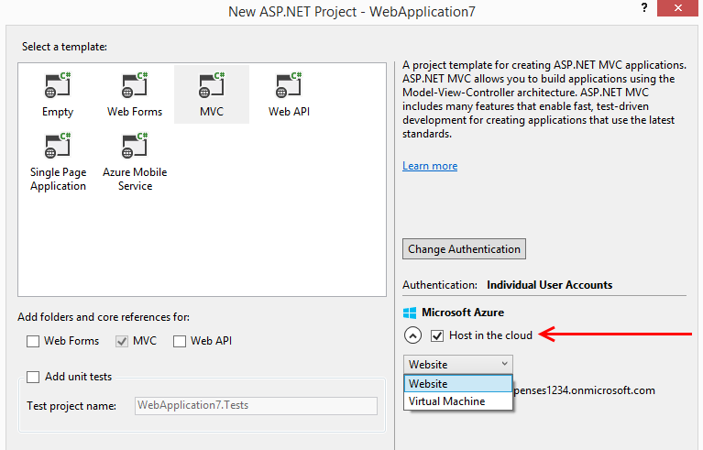
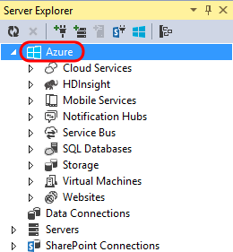
Visual Studio + Azure Websites
Create Azure Resources during File / New
Create Azure Website during deploy
Manage with Server Explorer

Slide 7
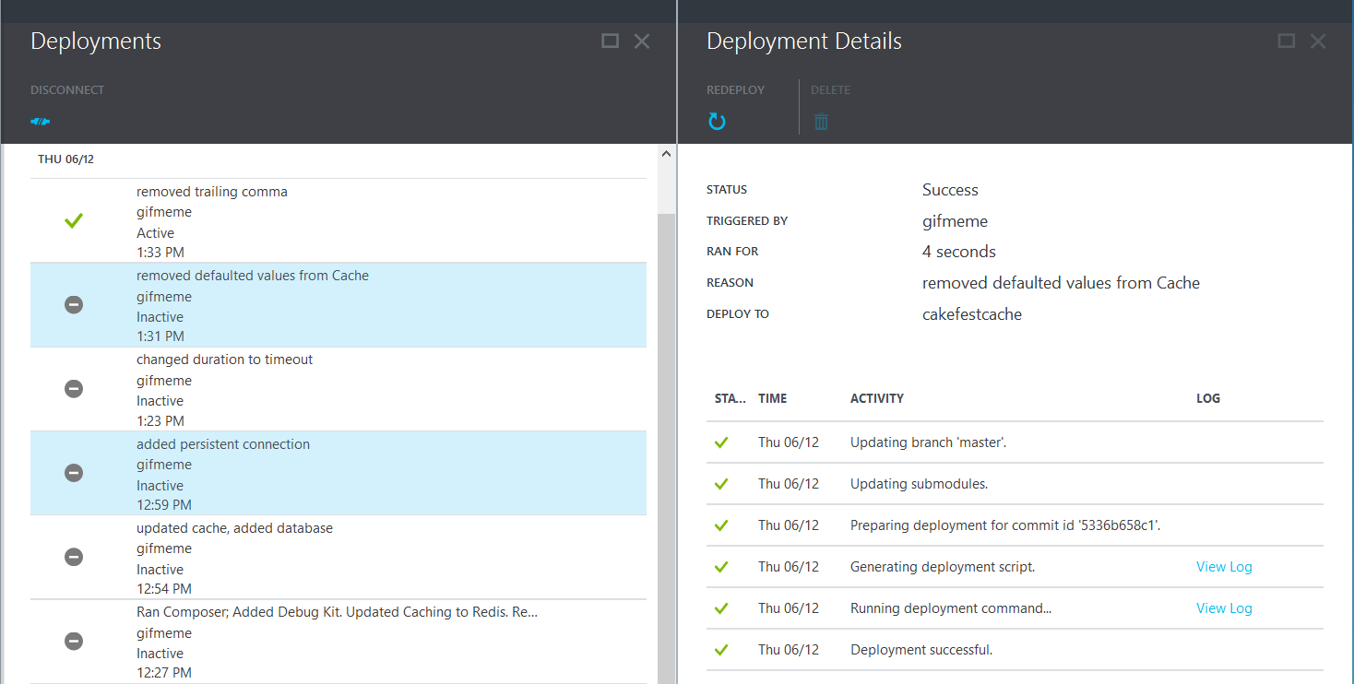
Deployments
Notes:
Websites include many manual deployment options from Visual Studio or WebMatrix, FTP, WebDeploy, via script or command line. An even better way to deploy is to setup a continuous delivery workflow integrated with your source control system, making the development process more efficient and repeatable. You can setup continuous deployment from Visual Studio Online, GitHub, TeamCity, Hudson or BitBucket.

Slide 8
Manual Scaling

Slide 9
Manual Scaling
Instance Count
1
6
Instances
Notes:
Besides scaling the hosting plan for a single website instance, it is also possible to scale out the number of instances of a website when the need arises to increase performance and throughput.
Changing modes and configuring them is easily done in the Scale tab of the management portal. You can scale up or down as required. These changes take only seconds to apply and affect all websites in your Web Hosting Plan. They do not require your code to be changed or your applications to be redeployed.

Slide 10
Auto Scaling

Slide 11
AutoScale
Notes:
It’s also possible to setup auto scaling rules for your website either based on a metric (say based on CPU, memory, or HTTP queue length) and even a schedule for when the rule is applicable. After getting the scaling rules configured, your website instance count will go up and even down in order to satisfy your requirements.

Slide 12
AutoScale
Notes:
Here we have more end-user traffic hitting the site.

Slide 13
AutoScale
Notes:
And more traffic... followed by a reduction in traffic after which Azure may automatically scale down.

Slide 14
Auto-Scaling (Metric)
Instance Count
2
6
Instances
[Metric]
60
80
Percent
CPU Percentage | Memory Percentage | Disk Queue Length | HTTP Queue Length | Data In | Data Out

Slide 15
Auto-Scale Considerations
Only Scales the Web Tier
Scale Up/Down is not instantaneous

Slide 16
Staging
Notes:
Azure Websites also have deployments slots built in that allow you to maintain multiple versions of the site. This allows you do create something like a staging environment for your deployments, where you can perform QA before finally making the live switch with the current production version of the site.

Slide 17
Staging

Slide 18
Staging

Slide 19
Staging
Notes:
Once the staging site passes QA, you can perform a nearly instant swap so that any new requests will be sent to the newly deployed site.

Slide 20
WebJobs
Notes:
Web Jobs enable you to run any program or script on VMs managed by Azure Websites. Run jobs continuously or on a schedule and scale to run on multiple VMs. You can even use an SDK to integrate the job with Azure Storage or Service Bus if needed.

Slide 21
WebJobs

Slide 22
Azure Websites & More

